Slide 1
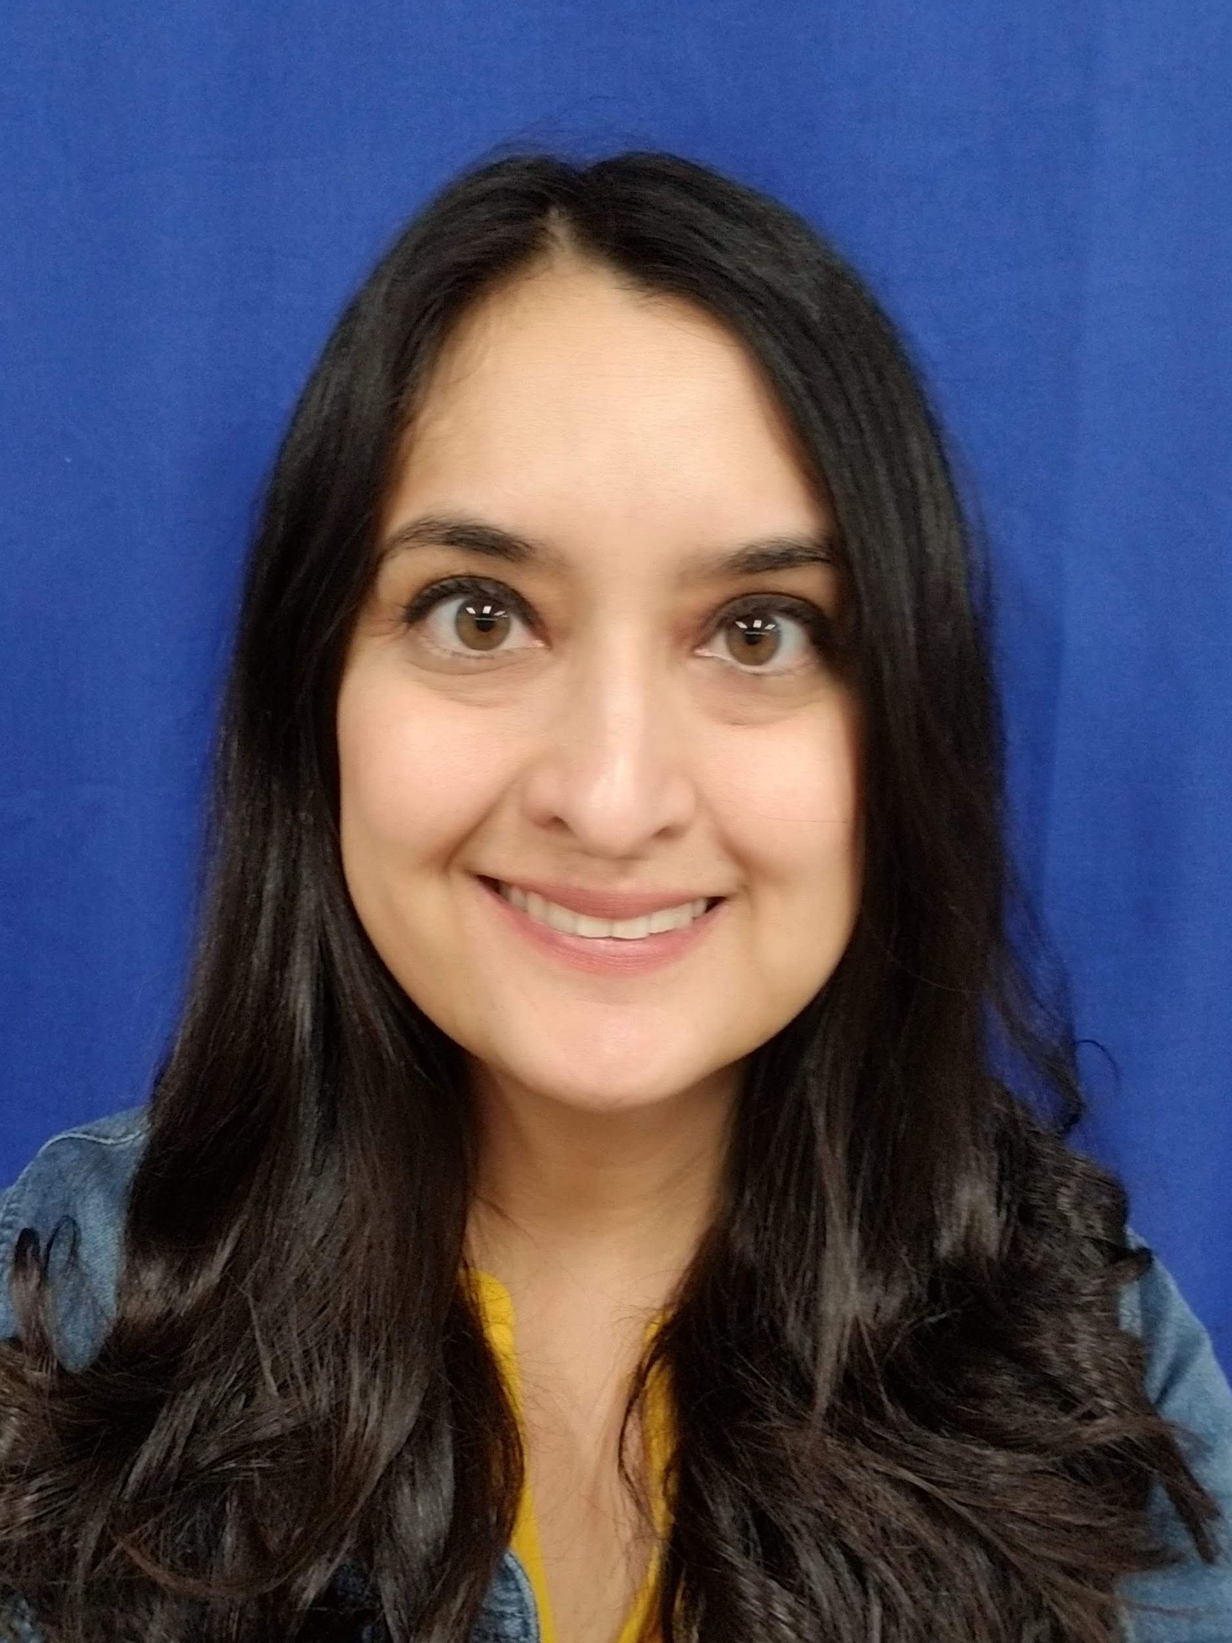
Back to School Night
Ms. Camacho
Social Science (P.1, 4, 5)
CTE/Journalism/ELA (P.2)
AVID Excel 7(P3)
2020-2021
Meeting code in Aeries for each period.
Notes:
Change the title from Seminar to either period or subject you teach.

Slide 2
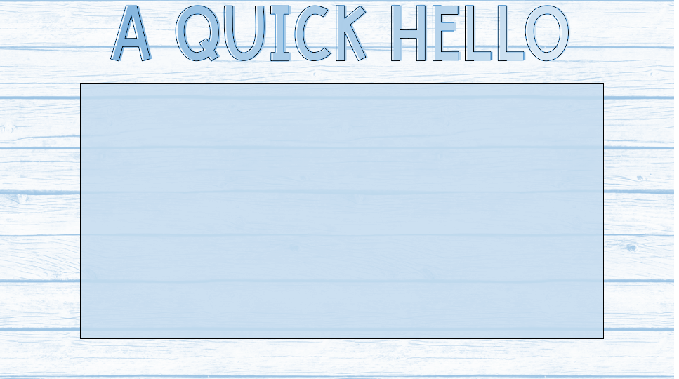
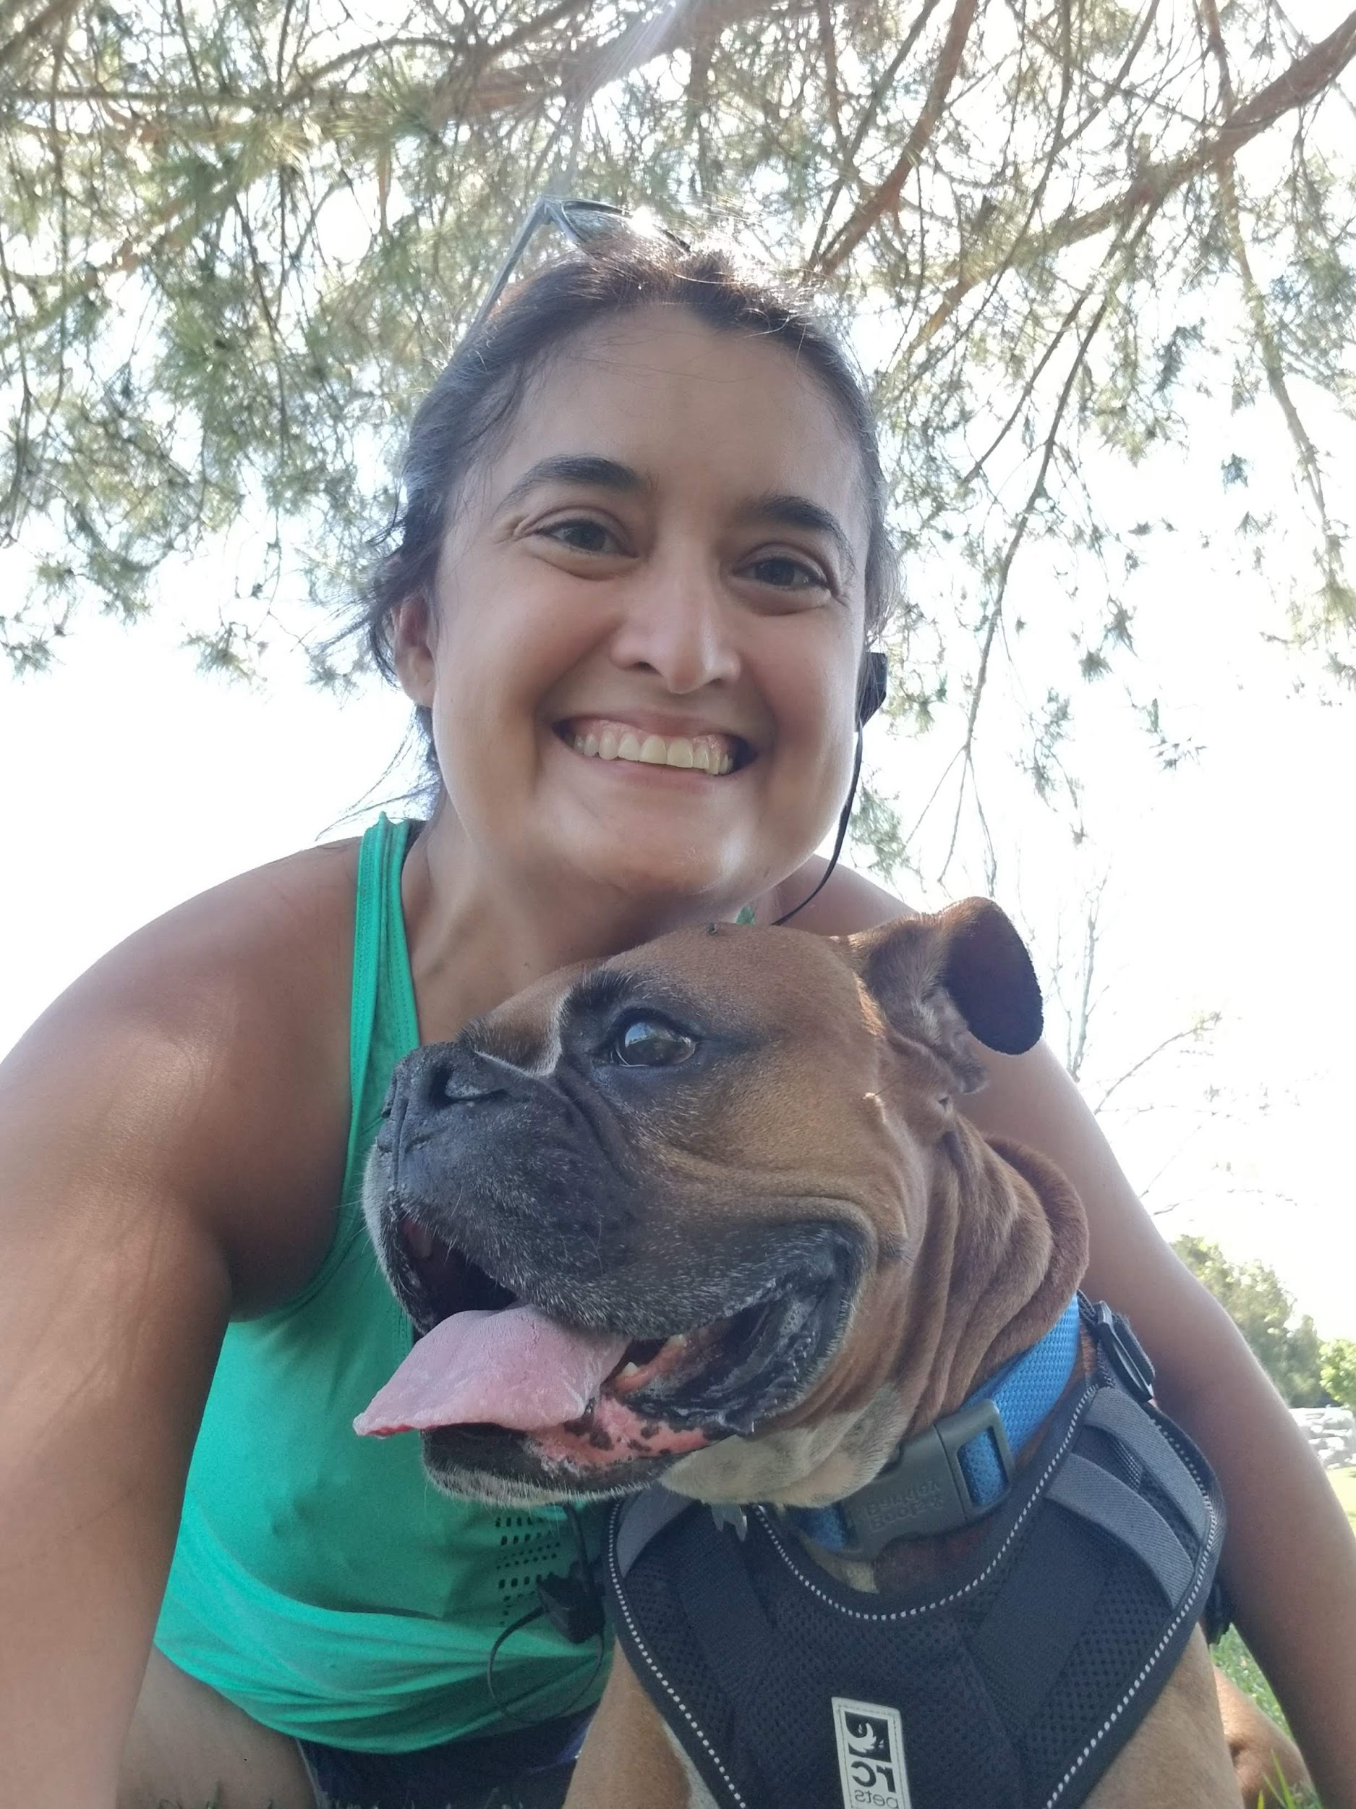
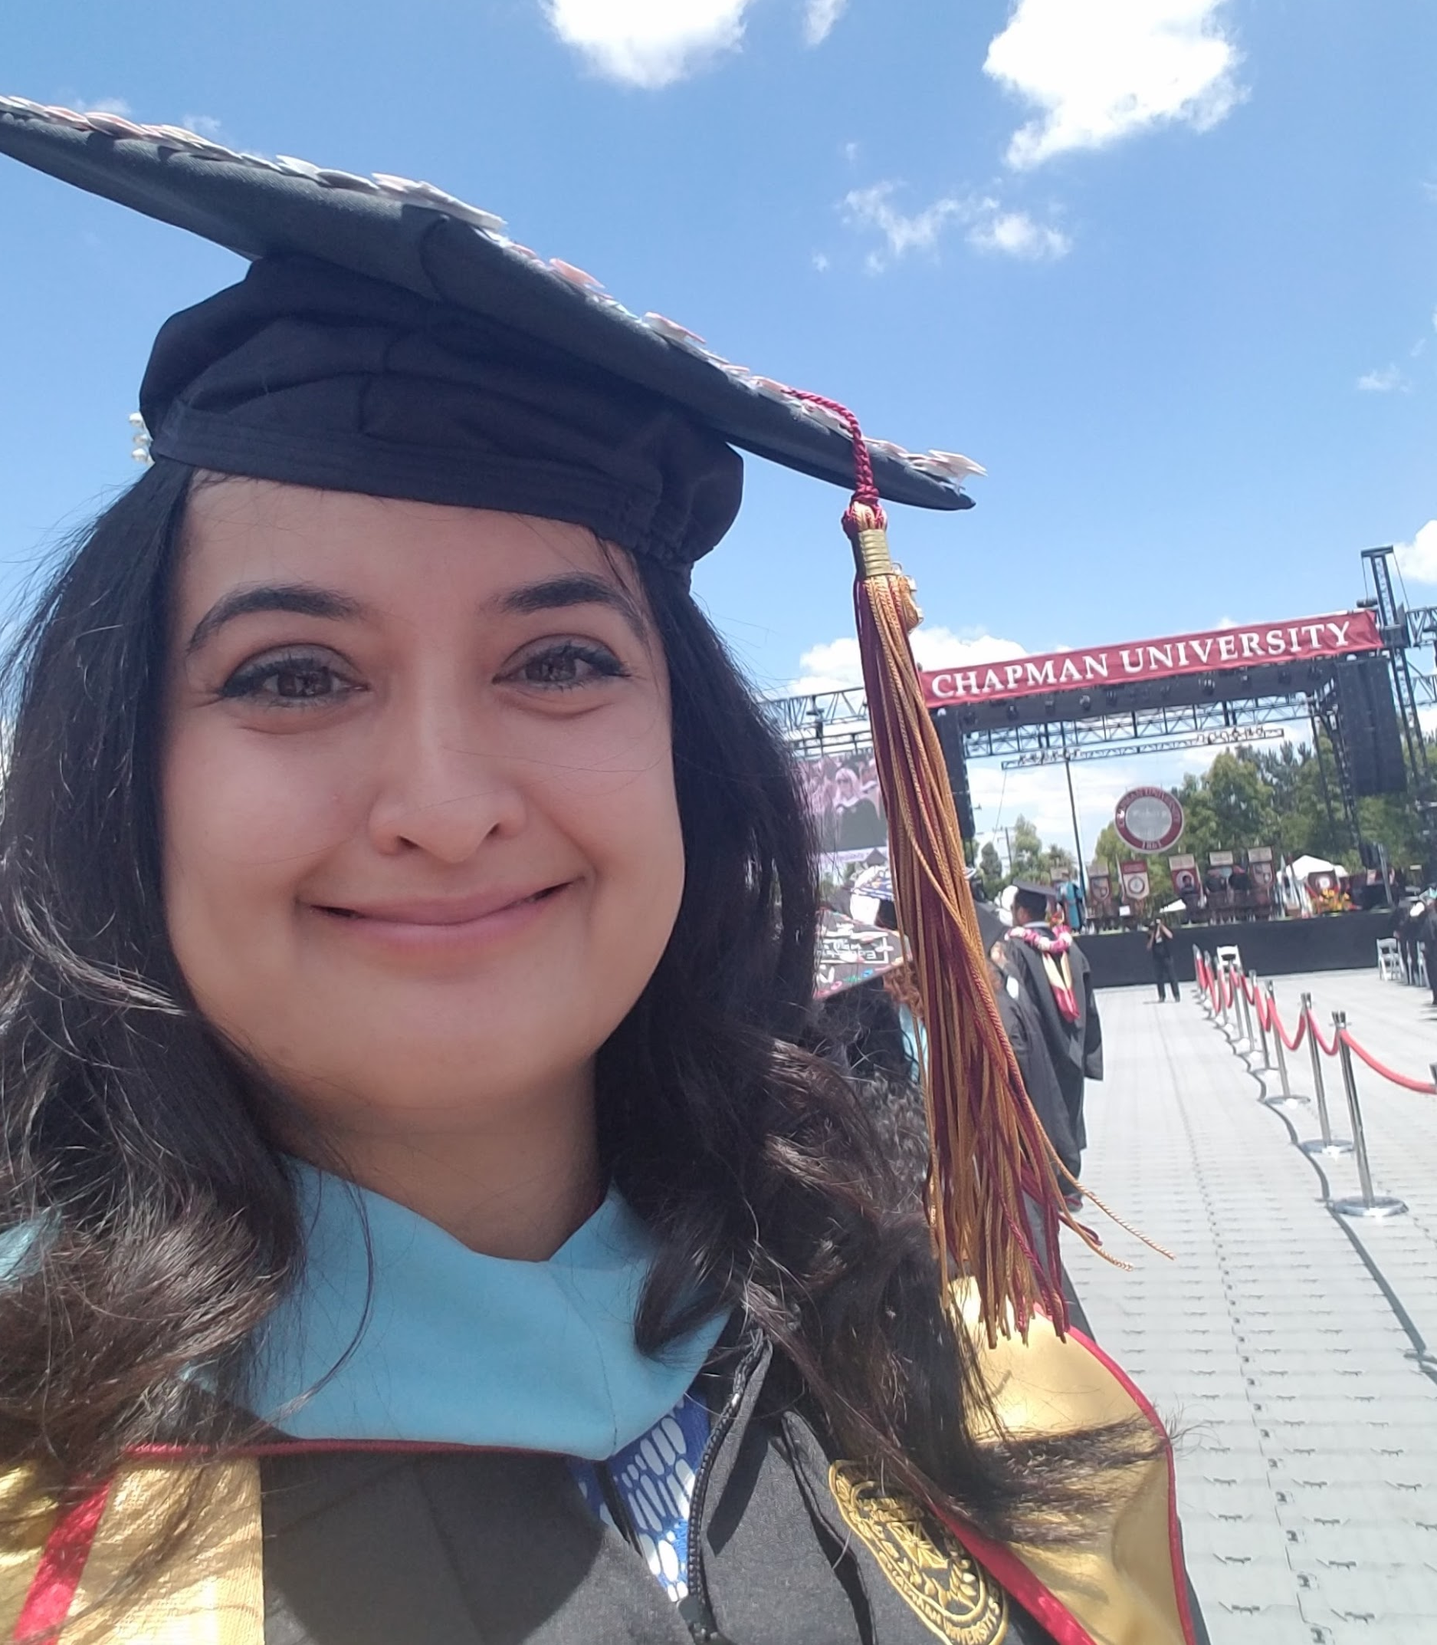
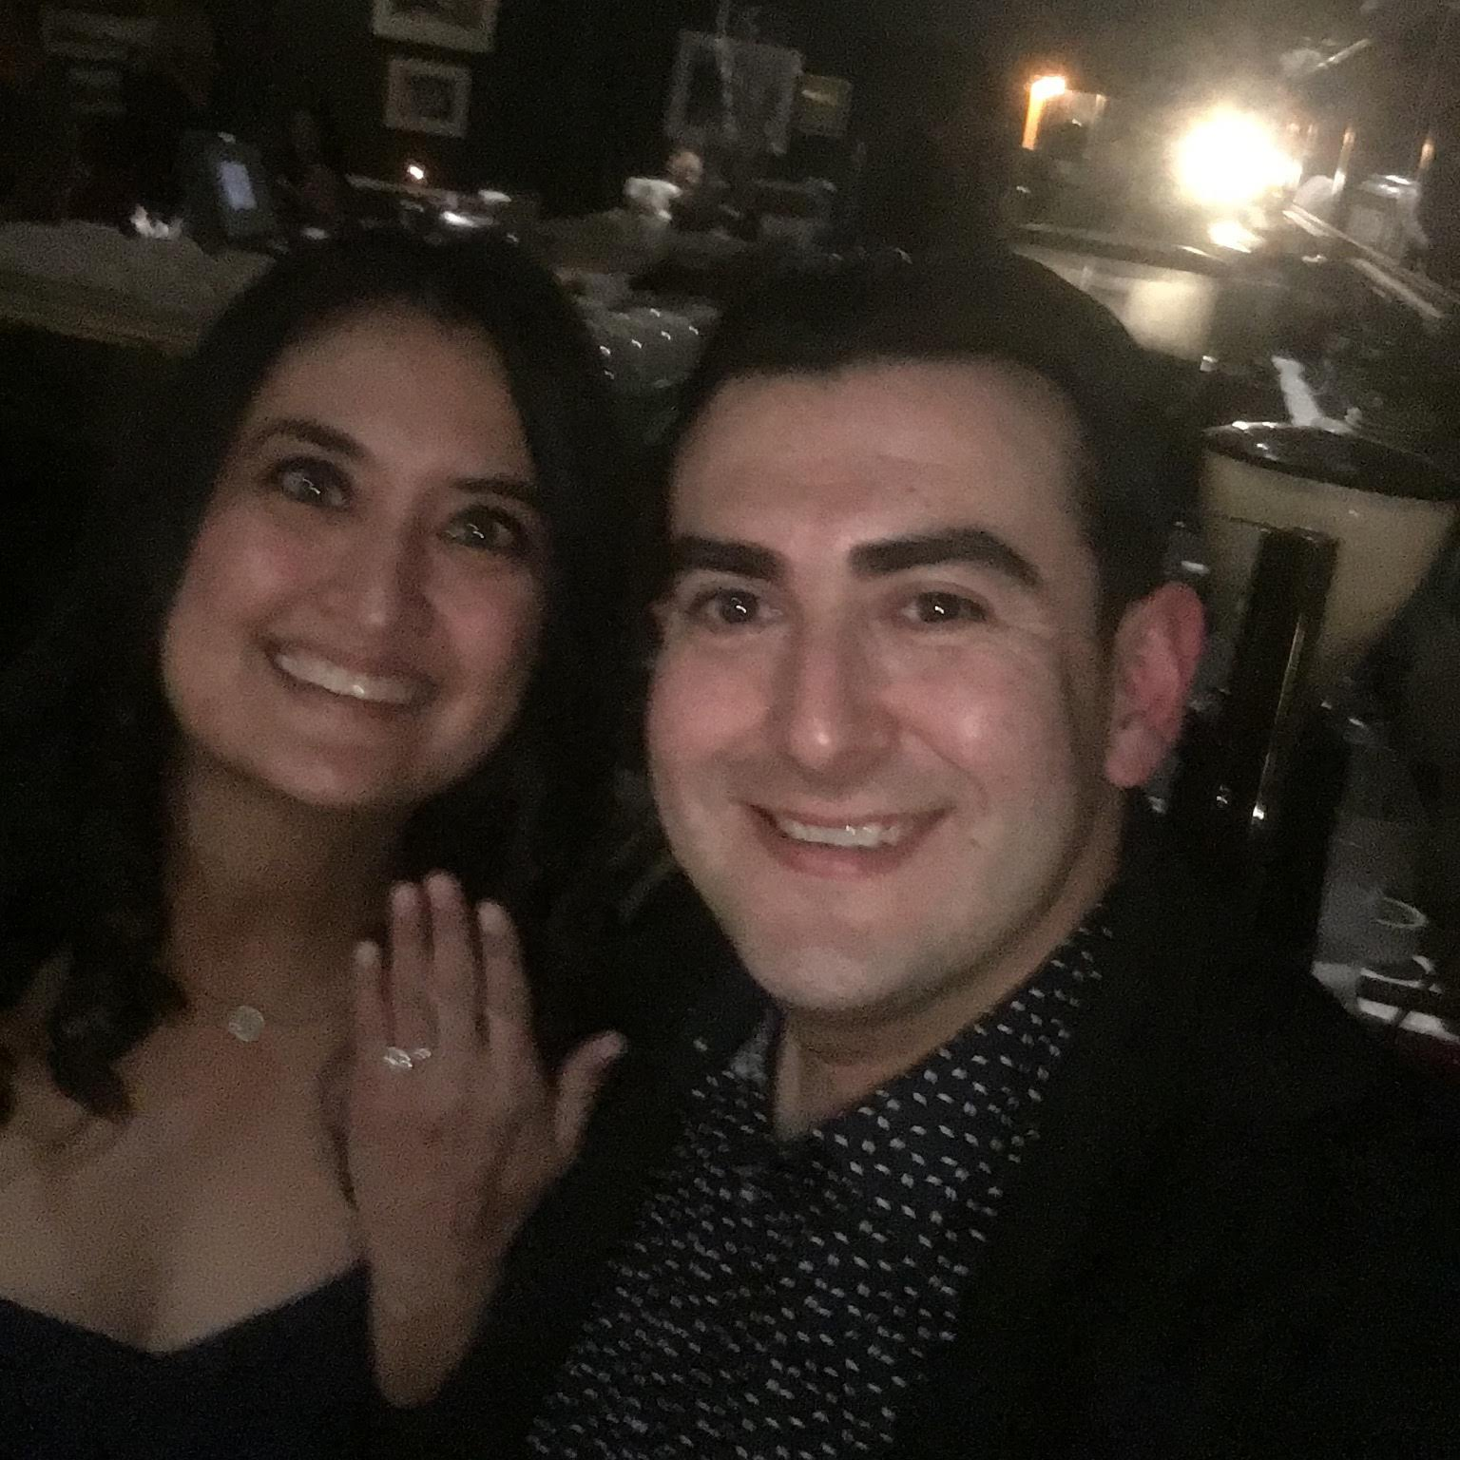
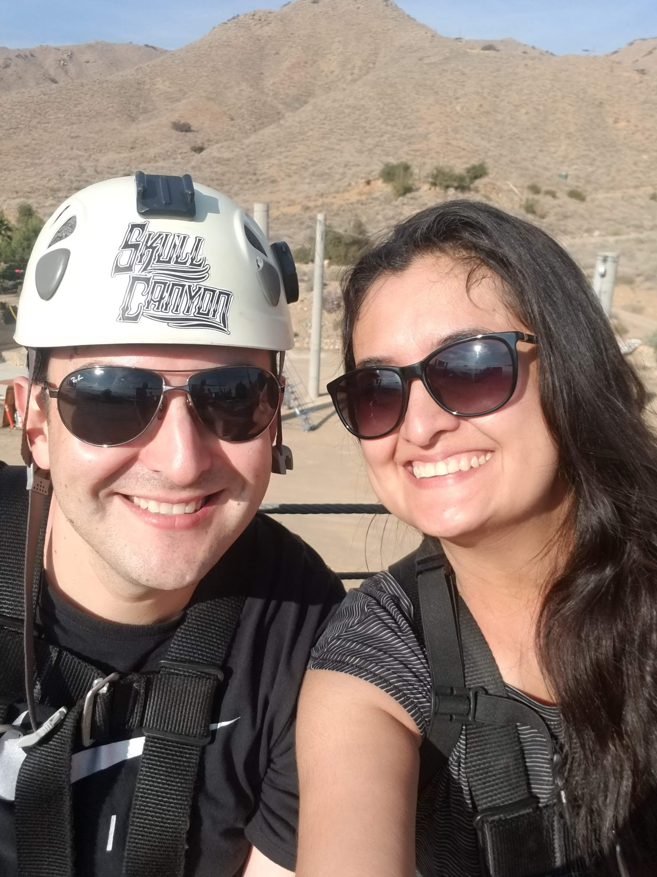
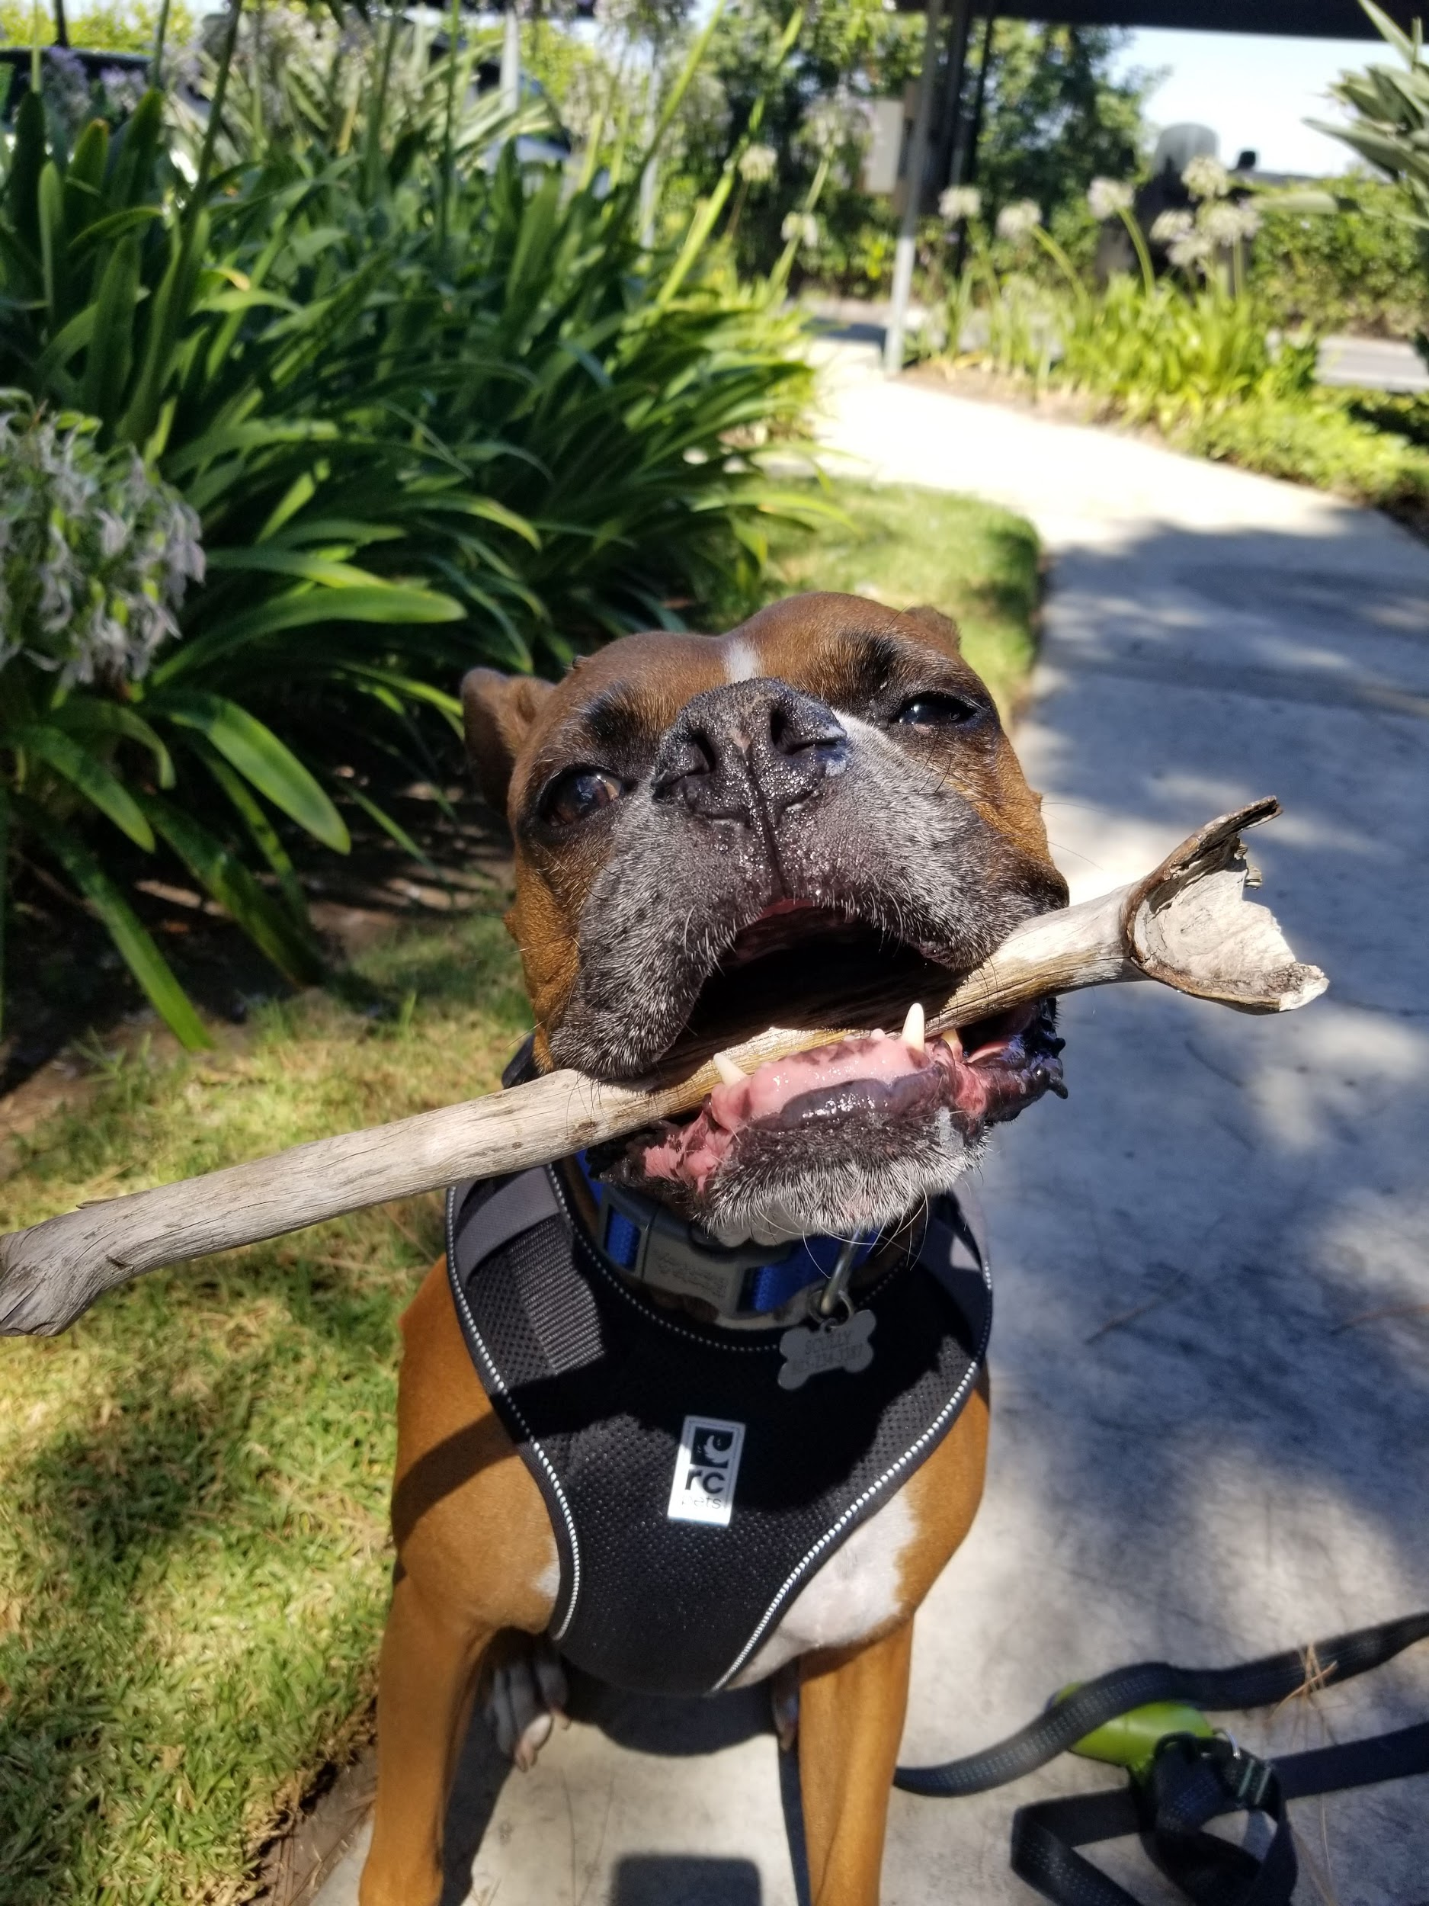
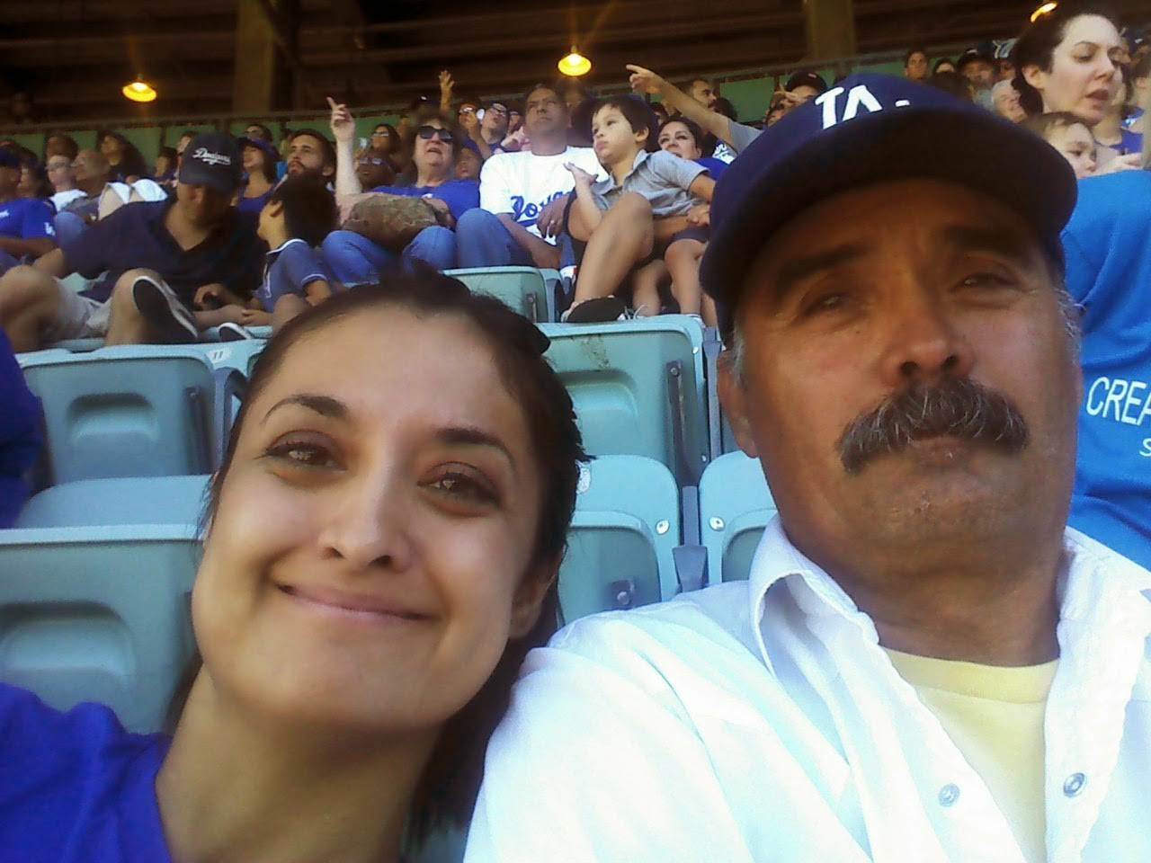
I’m so excited to meet all of my student’s families.
We will be starting off the school year with Digital Learning! We are excited to have you in our classes and at McFadden!
Can’t wait to start working with you.
Ms. Camacho

Slide 3
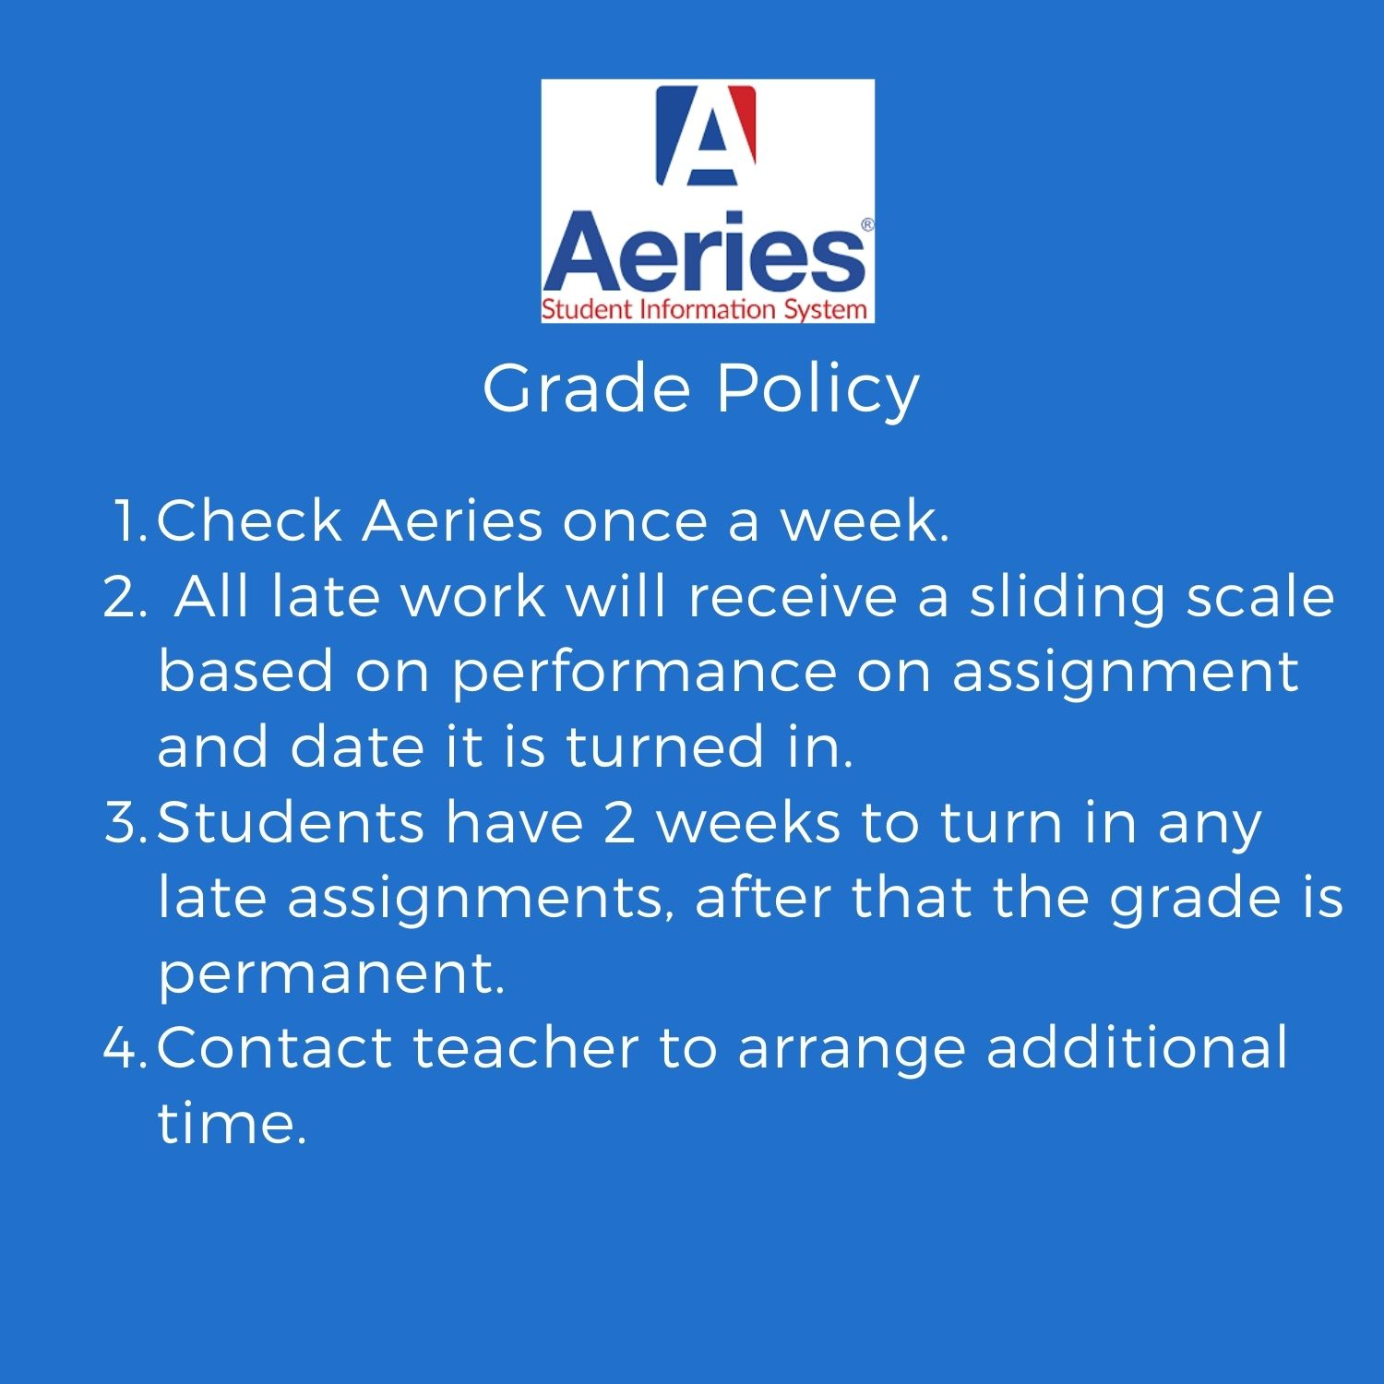
Class Expectations:
Students, parents and teachers work together to master study skills, collaborative skills, and become lifelong learners.
·
·
Notes:
Type in your classroom expectations- make sure they are in line with our school expectations for distance learning.

Slide 4
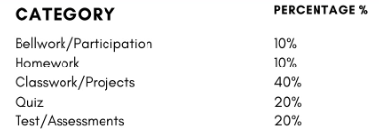
Class Expectations:
Students, parents and teachers work together to master study skills, collaborative skills, and become lifelong learners.
·
·
Notes:
Type in your classroom expectations- make sure they are in line with our school expectations for distance learning.

Slide 5
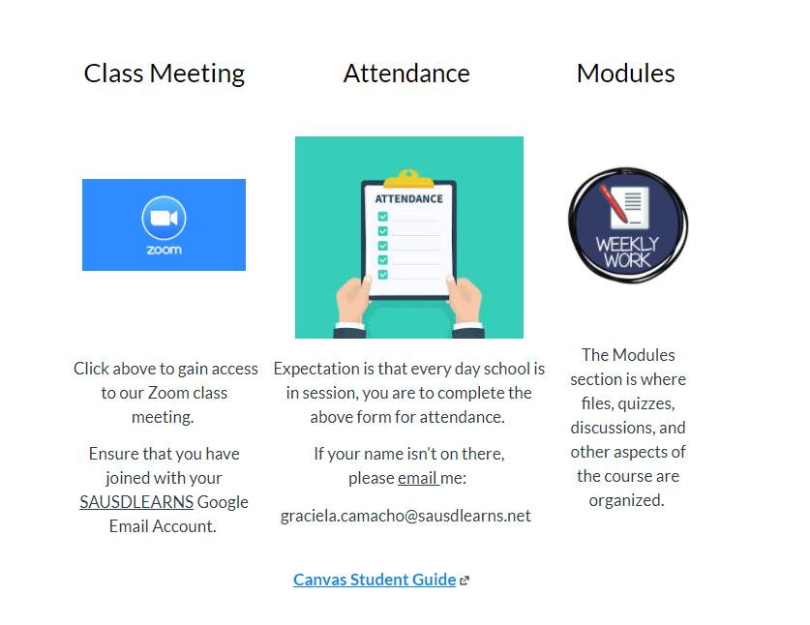
Canvas and Zoom
Links in Aeries
Links in Canvas
Notes:
Discuss the platform you are using and any details pertaining that are critical for parents to know. (ie codes.) Maybe show an image of what it looks like for a student.

Slide 6
Canvas- English- How to use
Notes:
Discuss the platform you are using and any details pertaining that are critical for parents to know. (ie codes.) Maybe show an image of what it looks like for a student.

Slide 7
Canvas-English-How to view grades.
Notes:
Discuss the platform you are using and any details pertaining that are critical for parents to know. (ie codes.) Maybe show an image of what it looks like for a student.

Slide 8
Canvas- Espanol.
Notes:
Discuss the platform you are using and any details pertaining that are critical for parents to know. (ie codes.) Maybe show an image of what it looks like for a student.

Slide 9
Grading policy
Notes:
Discuss your grading policy so that parents know the expectations

Slide 10
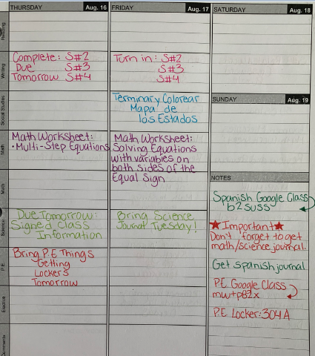
How parents can help at home:
Regularly check binders and backpacks to make sure your student is keeping up with organizational strategies on a daily basis (No loose paper, materials needed are present, assignments are in proper order).
Offer feedback for student so that binder “issues” can be remedied before checks.
Check school Agenda for: homework, due dates, tests, long-term assignments and add family events to the calendar to help students with time management of school work and
fun activities.

Slide 11
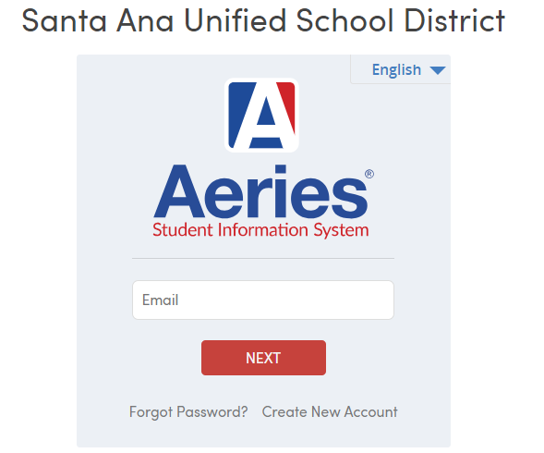
Aeries: Parent Portal
Connecting and communicating with parents is a primary goal at SAUSD. The portal provides details on items such as student attendance, grades, and test scores.
*1st grading period ends Friday, Sept 20th
Report card grades will be available on
Aeries Wednesday, Sept. 25th
Example - student login
Email: 6 digit student ID @sausdlearns.net
Password: 8 digit birthday
Link to SAUSD parent portal

Slide 12
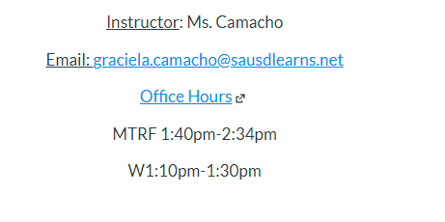
Office hours and how to get a hold teacher:
Zoom link in Aeries and Canvas
Notes:
Include information on how parents can get a hold of you. Email, parentsquare, instagram, etc…...

